Slide 1
Today’s Highlights
SR to T FF
JK to SR FF

Slide 2

Importance of Flip-Flop Conversion

Slide 3
SR TO JK FF conversion
Steps To Convert from One FlipFlop to Other : Making of conversion table of FF
Draw the characteristic table of required flipflop.
From the excitation table of given flip flop write corresponding output in conversion table.
Draw K-Maps using required flipflop inputs and output column of given flipflop inputs.
Construct logic diagram according to the functions obtained .

Slide 4
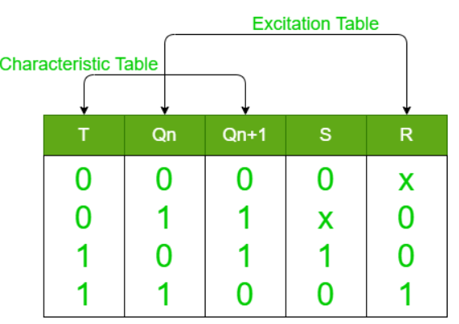
Step 1: Conversion Table

Slide 5
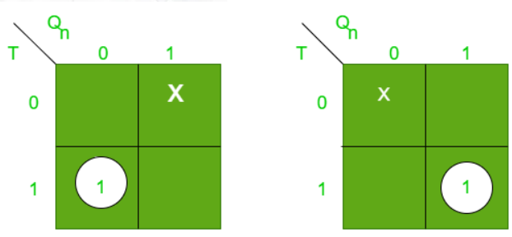

Step 2: K map

Slide 6
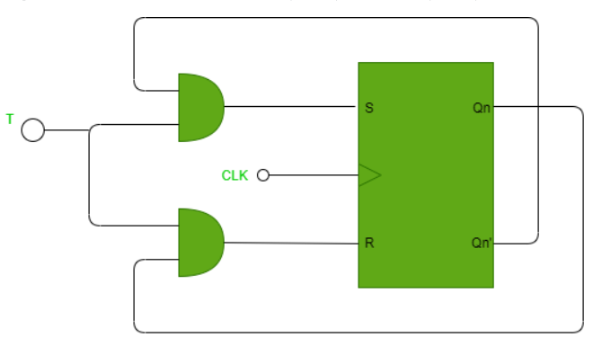
Step 3: Circuit diagram

Slide 7
QUICK QUIZ (POLL)
Why is SR flip-flop converted into a T flip-flop?
A) To enable toggling of the output B) To remove undefined states when S=R=1S = R = 1S=R=1 C) To simplify data storage D) To eliminate the need for a clock

Slide 8
QUICK QUIZ (POLL)
What condition is necessary for an SR flip-flop to behave as a T flip-flop?
A) S and R must be connected together B) S=0,R=1 C) S=R=T D) S=R=1

Slide 9
QUICK QUIZ (POLL)
. What happens when T=0 in the converted T flip-flop?
A) The output toggles B) The output is set to 1 C) The output is reset to 0 D) The output remains unchanged

Slide 10
JK TO SR FF conversion
Step 1
Write the excitation table of the flip flops.
2. Simplify the excitation table with the help of Karnaugh Map (K-map).
Draw the required logic circuit diagram.
Step 2
Step 3

Slide 11
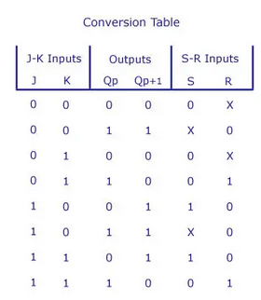
Step 1: Conversion Table

Slide 12
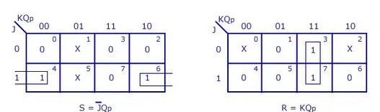
Step 2: K map

Slide 13
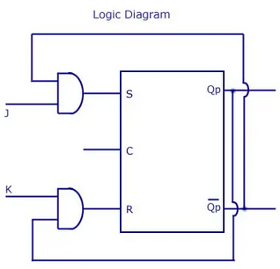
Step 3: Circuit diagram

Slide 14
QUICK QUIZ (POLL)
Why is JK flip-flop converted into an SR flip-flop?
A) To eliminate the toggling condition B) To remove undefined states C) To simplify the design for specific applications D) To ensure asynchronous operation

Slide 15
QUICK QUIZ (POLL)
What condition in the JK flip-flop corresponds to the undefined state in the SR flip-flop?
A) J=1,K=0 B) J=0,K=1 C) J=0,K=0 D) J=1,K=1

Slide 16
QUICK QUIZ (POLL)
In the converted SR flip-flop, what happens when J=1 and K=0?
A) The output toggles B) The output is set to 1 C) The output is reset to 0 D) The output remains unchanged

